Slide 1
IoTeye Inc.
Employee Engagement & Recognition Platform
Proposal for The Arc Mercer
April 2026 | Basking Ridge, NJ | www.ioteyeinc.com

Slide 2
Agenda
1. About IoTeye Inc. & Platform Ecosystem
2. BrainClaw AI Agents — Already at Arc Mercer
3. Understanding Your Challenge
4. Our Solution — Platform Overview
5. Key Features Deep Dive
6. Paycom Integration & SSO
7. Accessibility & Mobile-First Design
8. Phased Implementation Timeline
9. Pricing Options
10. Why IoTeye — Next Steps

Slide 3
About IoTeye Inc.
Who We Are
Our Products
• Remote software company — Basking Ridge, NJ
• 5+ years building special care software
• 1,000+ consumers across our platforms
• Core domain: Special Care sector
• Full-stack SaaS expertise: design → deploy → support
• SpringBoard: Multi-agency route management & operations (route opt., fleet, Twilio SMS, multi-tenant)
• BrainBook: AI platform — Next.js/React/TypeScript, Supabase, AI agents, voice I/O, desktop & web
• Guardian: Notification system — SMS, push notifications, reply tracking, iOS & Android
• BrainClaw: AI agent gateway (GPT-4.1) — 37-tool SpringBoard agent & 57-tool Samsara agent live at Arc Mercer

Slide 4
Total Agency Services for Special Care
Special Care Cloud (AWS)
Platform Products
• Market: 6,000+ special care agencies in the USA
• Agentic AI Platform — Cloud, Desktop, Mobile, IoT
• Personal AI assistants for agency workflows
• Apps for Parent/Guardian, Consumer/Patient, Staff/Driver
• IoT: OBD, DashCam, Minew Proximity, Home Assistant Green
• Samsara App Partner — fleet telematics
• HIPAA-compliant AI inference servers
SpringBoard
Route/Fleet — paratransit ops, multi-tenant
Guardian
Notifications — SMS, push, reply tracking
BrainBook
AI Platform — desktop, web, mobile, voice I/O
BrainClaw
AI Agents — 94+ tools, GPT-4.1, Arc Mercer live

Slide 5
BrainClaw AI Agents — Already at Arc Mercer
In Production at Arc Mercer Today
Extending to Recognition Platform
Powered by BrainClaw + GPT-4.1 (GitHub Copilot)
Natural language for HR & leadership:
• SpringBoard Agent — 37 tools
• Routes, fleet, consumers, optimization, SMS, GPS, SOS
• Samsara Agent — 57 tools
• Vehicles, drivers, HOS, safety events, DVIRs, GPS
• "Which program had most nominations last month?"
• "Who hasn't been recognized in 60+ days?"
• "Flag unusual point bestowals this week"
• "Generate Q1 engagement report as CSV"
• "What's our engagement score this month?"
Arc Mercer staff use natural language today:
"Optimize routes for Weekday AM" "Where is vehicle 147 right now?" "SMS all Residential drivers — 10 min delay" "Generate daily manifest for Arc Mercer"
★ Optional add-on — same BrainBook UI Arc Mercer already uses

Slide 6
Understanding Your Challenge
The Arc Mercer's Current State
What You Need
• Manual recognition processes — inconsistent, hard to track
• Multiple programs (Residential, Day Programs) operating in silos
• Frontline staff with varying technical literacy
• No centralized system for nominations or point tracking
• No connection to Paycom HRIS for employee data
• Centralized, web-based recognition platform
• Program-based competition engine
• Multi-stream point system with audit trails
• Rewards marketplace for merchandise & gift cards
• Paycom integration & SSO
• Mobile-first, accessible to all staff

Slide 7
Our Solution — Platform Overview
Custom-Built SaaS — Tailored for The Arc Mercer
React + TypeScript PWA
Mobile-first responsive design, offline capable
Supabase (PostgreSQL)
Auth, real-time subscriptions, Row Level Security
Python (FastAPI)
Paycom SFTP sync, gift card APIs, scheduled jobs
AWS Cloud
ECS Fargate, CloudFront, S3, WAF, CloudWatch
Security: AES-256 at rest | TLS 1.3 in transit | WCAG AAA | Full audit logging

Slide 8
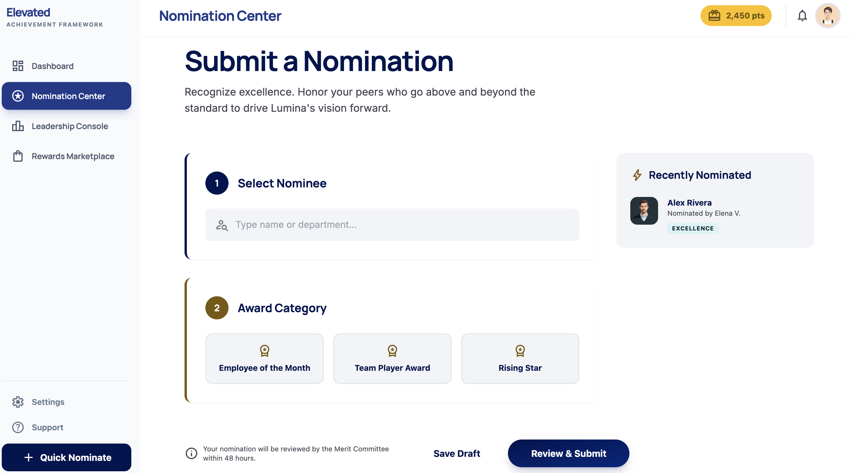
Program-Based Competition Engine
Nominations
• 3 award types: Employee of the Month, Rising Star, Team Impact
• Step-by-step guided form with large buttons
• 1 nomination per candidate/month, 5 total/month
• Friendly feedback when limits reached
QA Queue & Programs
• Approve / Return for Edits / Decline
• Points awarded only upon admin approval
• Filter by program, award type, date, status
• Programs synced from Paycom automatically

Slide 9
Point Allocation & Engagement Tracking
Multi-Stream Point Accrual
Audit & Transparency
Point Stream
Trigger
• Immutable transaction log for every point change
• Timestamp, actor, action, amount, reason
• Filterable by employee, program, date, type
• Export to CSV for external review
• Anomaly highlighting for oversight
• Top-down bestowal with instant notifications
Employee / Rising Star / Team Impact (Approved)
QA queue approval
TAC Meeting Attendance
Admin check-in
Newsletter Trivia
Correct answer
Birthday / Anniversary
Automated (Paycom sync)
Leadership Bestowal
Manual award
All point values are admin-configurable — no code changes needed

Slide 10
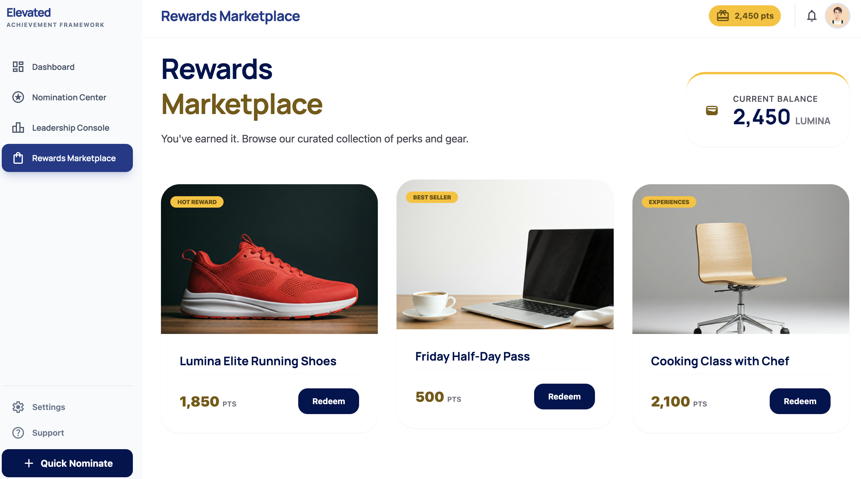
Rewards Marketplace
Digital Storefront
• Visual catalog with images, point costs, descriptions
• Categories: Merchandise, Cafeteria Meals, Gift Cards
• Real-time point balance during browsing
• One-tap redemption with confirmation
• Order history for employees
Admin Fulfillment Tools
• Inventory management (add/edit items, stock levels)
• Low-stock alerts, out-of-stock auto-hiding
• Order queue: Pending → Processing → Fulfilled
• Digital gift card: API-based instant delivery
• Gift card fees: 3-5% vendor markup (pass-through)

Slide 11
Paycom Integration & SSO
Paycom HRIS Integration
Single Sign-On (SSO)
• Primary: SFTP nightly file export (CSV/XML)
• Python ETL service parses & syncs to Supabase
• Auto-provision new hires, deactivate terminations
• Sync: Employee ID, name, email, program, hire date, DOB
• Discrepancy reports flagged for HR review
• Optional: REST API enhancement (if subscription supports)
• Supabase Auth: SAML 2.0, OAuth 2.0, OIDC
• Initial: Google Workspace SSO (current provider)
• Future: Microsoft Entra ID — zero-downtime migration
• Both providers can run in parallel during transition
• Fallback: email/password for part-time staff
• Employee clicks 'Sign In' → Google login → done
Paycom → SFTP Export → AWS S3 → Python ETL ↓ Supabase (PostgreSQL) ↓ React Front End (Live Data)

Slide 12
Accessibility & Mobile-First Design
Design philosophy: "Could someone who only uses their phone for calls and texts do this?"
Universal Design
Mobile-First PWA
• Large touch targets: 48×48px minimum
• WCAG AAA contrast (7:1 ratio)
• Icon-driven navigation — not text-dependent
• 6th grade reading level for all text
• Progressive disclosure — one action per screen
• Keyboard navigable, screen reader compatible
• Progressive Web App (PWA) — no app store needed
• Works on any smartphone, 320px+ screens
• Low-bandwidth friendly, lazy-loaded images
• Bottom nav: Home, Nominate, Store, Points, Profile
• Touch-optimized: swipe, pull-to-refresh
• Accessibility audit before each phase launch

Slide 13
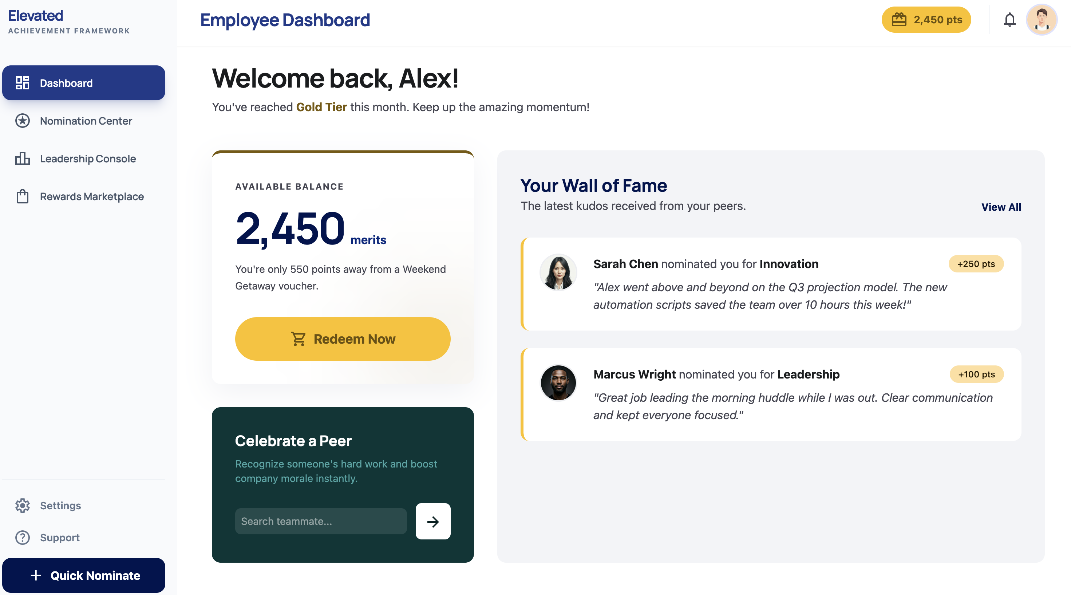
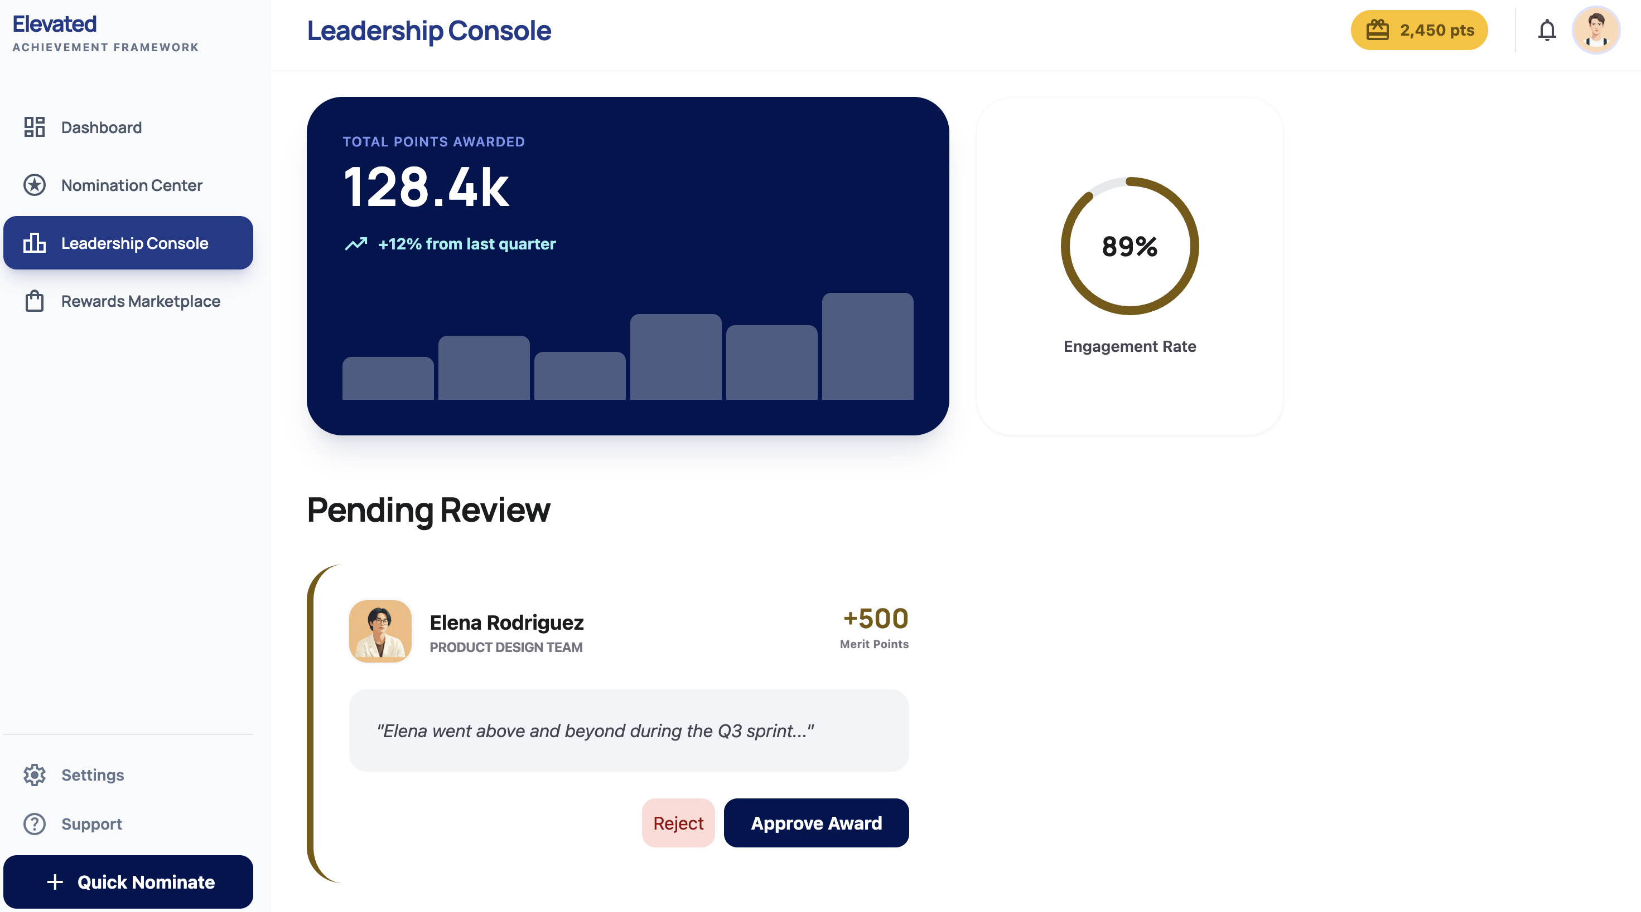
Dashboards — Employee & Leadership
Employee Dashboard
Leadership Console
Points Balance • Wall of Fame • Quick Nominate
Total Points • Engagement Rate • QA Pending Review
All dashboards are real-time • Mobile-first • Accessible on any device • Role-based visibility

Slide 14
Phased Implementation — 36 Weeks
Phase 1: Foundation (Weeks 1–12)
Phase 2: Engagement (Weeks 13–24)
Phase 3: Marketplace (Weeks 25–36)
Phase 1 Deliverables
Phase 2 Deliverables
Phase 3 Deliverables
• Nomination portal (3 award types)
• QA queue (approve/return/decline)
• Paycom SFTP sync
• Google Workspace SSO
• Manual point bestowal + audit trail
• Employee dashboards
• Leadership analytics
• Automated birthday/anniversary awards
• TAC attendance & trivia tracking
• Push/email notifications
• Digital rewards storefront
• Physical & digital fulfillment
• Gift card instant delivery
• Inventory management
• Complete platform go-live

Slide 15
Pricing — Option A: Source-Code Ownership
The Arc Mercer owns all source code, database, and IP
Phase
Hours
Cost
Annual Recurring
Phase 1: Nominations, Paycom, SSO, Infrastructure
~480 hrs
$45,000
• AWS hosting/CDN/monitoring: $6,000
• Supabase Pro Plan: $3,000
• SSL & domain: $200
• Maintenance & support: $12,000
• Total annual: $21,200/year
Phase 2: Dashboards, Tracking, Notifications
~310 hrs
$35,000
Phase 3: Marketplace, Gift Cards, Fulfillment
~280 hrs
$30,000
Total Implementation
~1,070 hrs
$110,000
Blended rate: ~$103/hr — well below $150-250/hr industry standard
Year 1 Total: $131,200
Year 2+: $21,200/year

Slide 16
Pricing — Option B: IoTeye-Hosted SaaS
No upfront cost — IoTeye retains platform ownership & offers managed service
Pricing
What's Included
• Implementation fee: $0
• Monthly subscription: $2,500/month
• Annual total: $30,000/year
• Minimum commitment: 3-year term
• All 3 phases (same 36-week timeline)
• Hosting, maintenance, security updates
• Ongoing support & platform updates
• No per-user fees
Option A vs. Option B — Cost Comparison
Option A (Own Code)
Option B (SaaS)
Upfront Cost
$110,000
$0
Annual Cost
$21,200/year
$30,000/year
3-Year Total
$173,600
$90,000
5-Year Total
$216,000
$150,000
Code Ownership
Yes — you own it
No — IoTeye retains

Slide 17
Why IoTeye — Next Steps
Why We're the Right Partner
Next Steps
• 5+ years in special care software — we know your workforce
• Arc Mercer is an existing SpringBoard & Guardian customer
• BrainClaw AI agents already running at Arc Mercer (37+57 tools)
• Production platforms: SpringBoard, BrainBook, Guardian, BrainClaw
• Same tech stack (React, Supabase, Python, AWS) — proven
• Mobile-first, accessible design as a core competency
• Flexible pricing: own the code or pay-as-you-go SaaS
• Select pricing option (A or B)
• Schedule kickoff & discovery workshop
• Initiate Paycom SFTP access setup
• Configure Google Workspace SSO
• Phase One live in 12 weeks
Contact Us
IoTeye Inc. Basking Ridge, New Jersey mingjye.sheng@ioteyeinc.com www.ioteyeinc.com
Thank You

